Slide 1
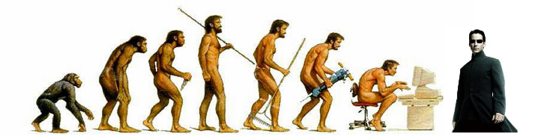
Genetic Algorithms
Solving by evolving
Pawel Drozdowski – November 2012

Slide 2
Agenda
Introduction
GA basics
Solving simple problem
GA more advanced topics
Solving complex problem
Question and Answers

Slide 3
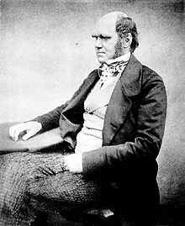
Introduction
Evolution
Evolution is the change of inherited characteristics of populations over successive generations what leads to greater diversity in this populations.
Greater diversity leads to greater chance of survival in changing environment.
Charles Darwin 1809 -1882

Slide 4
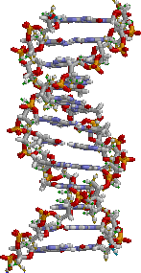
Introduction
Genetics
Genetics is the science of genes.
Genes are a part of DNA molecule which carries information how to build cells and pass traits to offspring.
DNA

Slide 5
Introduction
Assuming…
Offspring genes keeps information of inherited characteristics.
Populations use genes diversity to survive in environment.

Slide 6
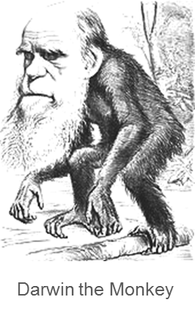
Introduction
…and that’s how creationists see it

Slide 7
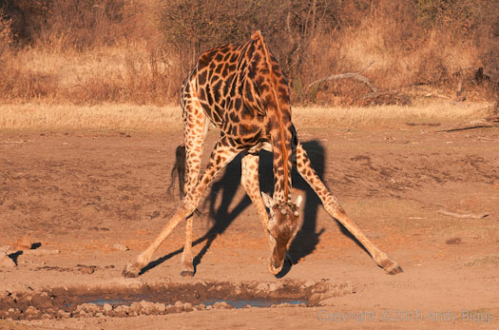
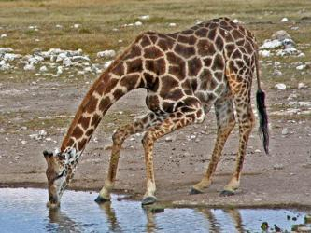
Introduction
Evolved, created… or neither?

Slide 8
GA
Genetic Algorithm (GA)
1. Generate population
2. Calculate fitness
3. Make selection
4.Crossover
5. Mutate
Go to 2
Done

Slide 9
GA
Parts of Genetic Algorithm
Chromosome and genes
Population
Fitness function
Selection method
Crossover method
Mutation method
Stop conditions

Slide 10
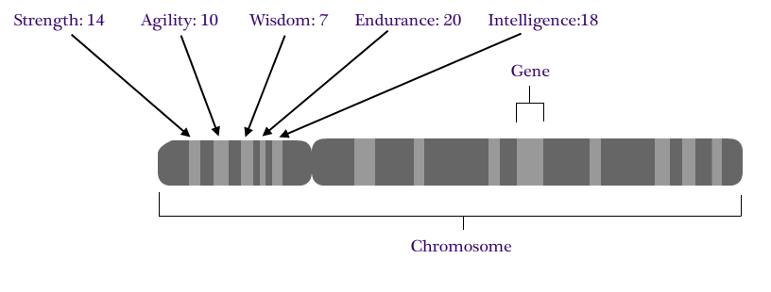
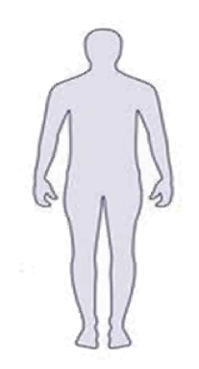
GA – Chromosome and genes

Slide 11
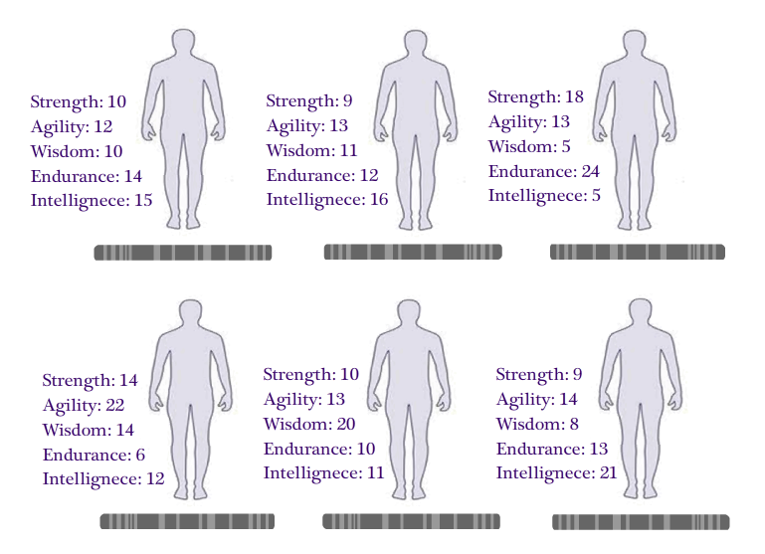
GA - Population

Slide 12
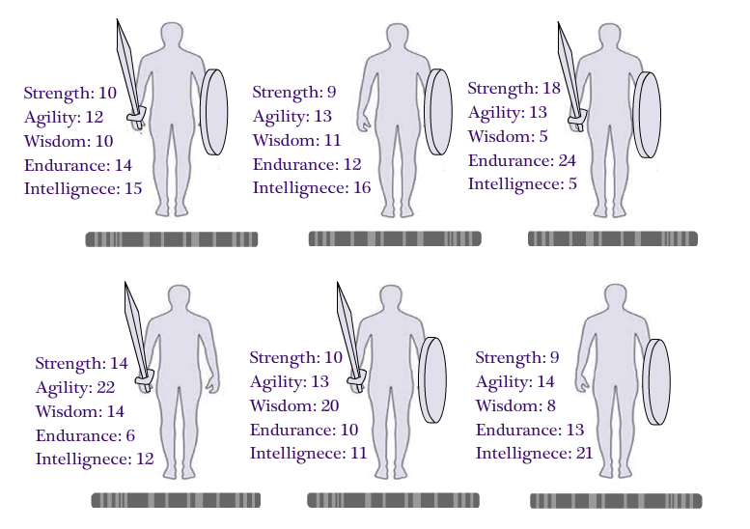
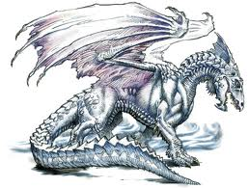

GA - Fitness
Score: 24
Score: 21
Score: 42
Score: 20
Score: 20
Score: 22
Fitness function: Strength + Endurance
DNA

Slide 13

GA - Selection
Score: 24
Score: 21
Score: 42
Score: 20
Score: 20
Score: 22
Fitness function: Strength + Endurance > 22
DNA

Slide 14
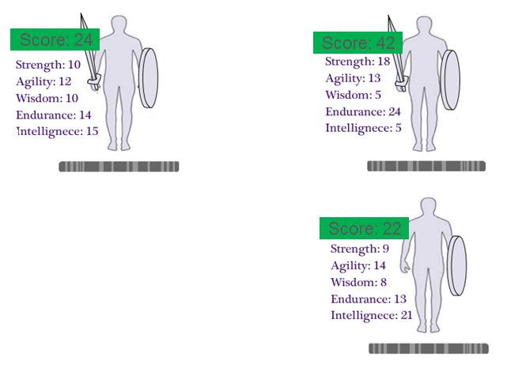
GA - Selection

Slide 15
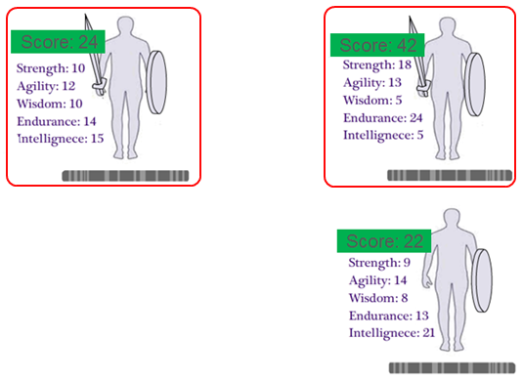
GA - Selection
I have no sword so I won’t reproduce ☹

Slide 16
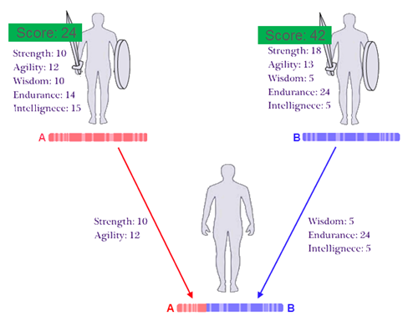
GA - Crossover

Slide 17
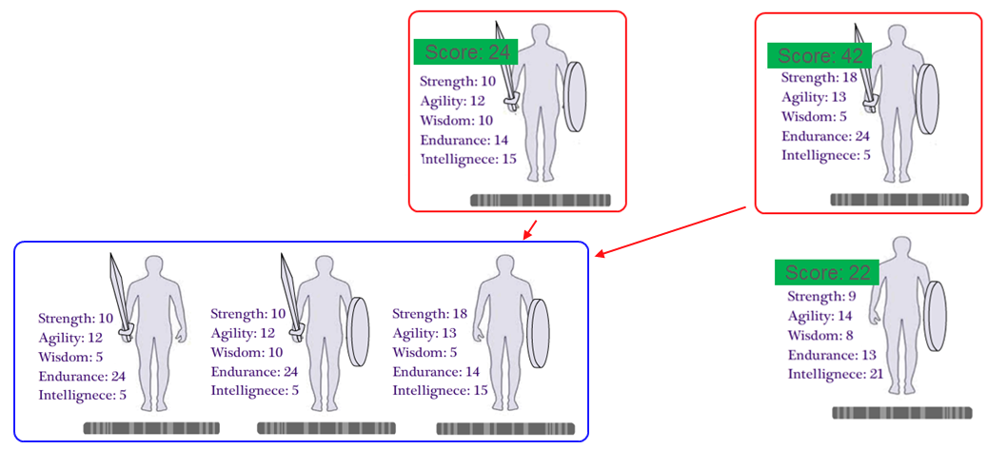
GA - Crossover

Slide 18
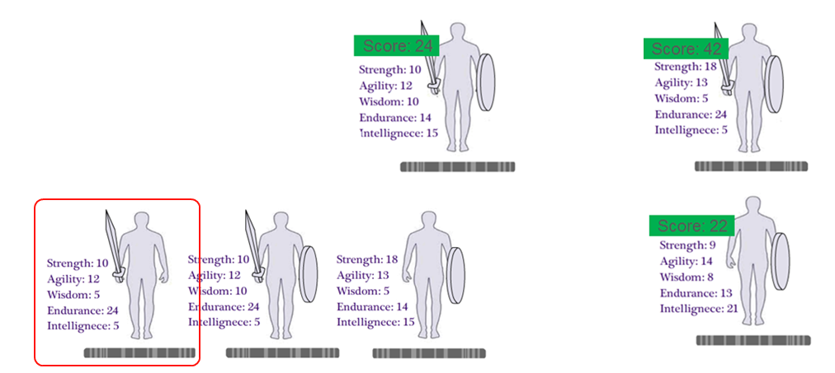
GA - Mutation
DNA

Slide 19
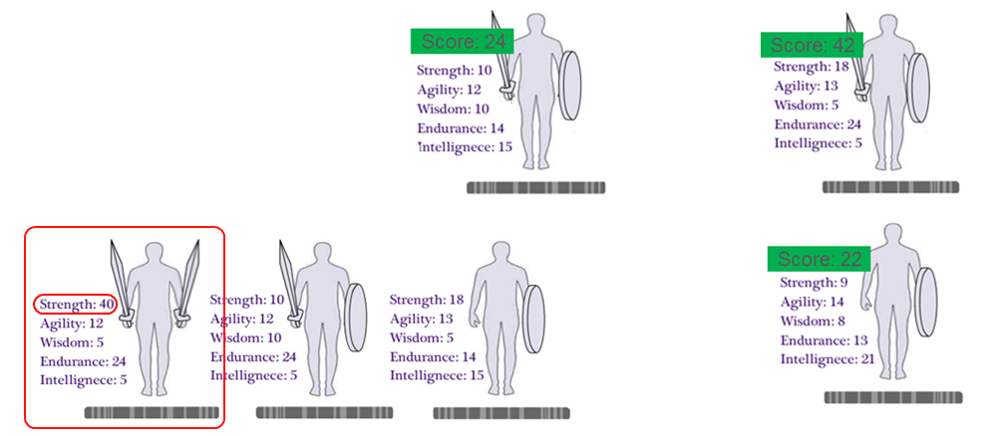
GA - Mutation
DNA

Slide 20
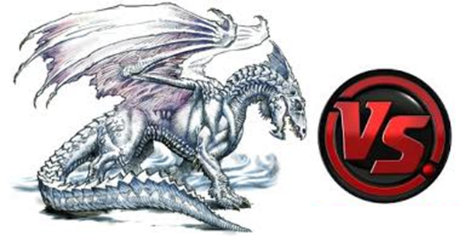
GA – Repeat all steps until dragon slain
Score: 34
Score: 32
Score: 64
DNA

Slide 21

GA – Stop condition met
Score: 34
Score: 32
Score: 64
DNA

Slide 22
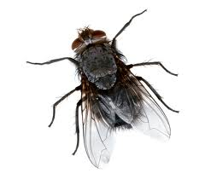
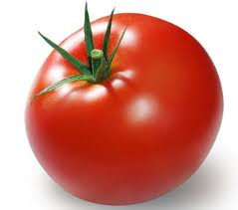
Solving simple problems
DEMO1
Flies vs Tomatoes
This demo uses AForge.Net library, check: www.aforgenet.com

Slide 23
Flies vs Tomatoes
Definition
There are tomatoes and flies in the space.
Flies likes to eat tomatoes.
Task
Depending on different distribution of tomatoes
in space find out most likely place where
flies would be.

Slide 24
Flies vs Tomatoes
Chromosome
Array of 2 double values represented as sequence of bits
{ X Y }
Example: {0.41, 0.32}
X,Y pair defines location of a fly in the space

Slide 25
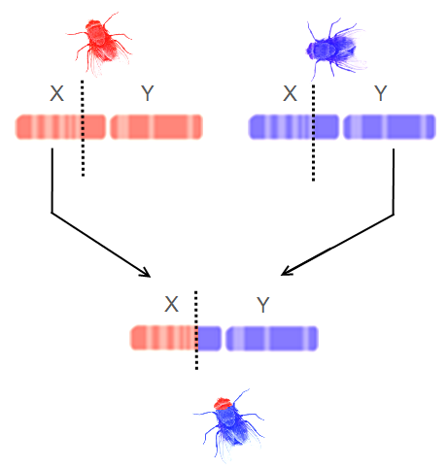

Flies vs Tomatoes
Crossover Single cut
Mutation
Gene value swap
X
Y
X
Y
X
Y

Slide 26
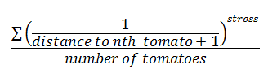
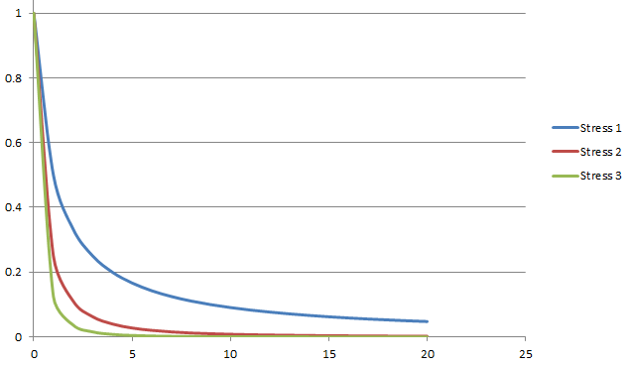
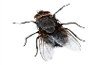

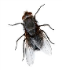
Flies vs Tomatoes
Fitness function
0.2
0.75
0.95
0.4
0.5

Slide 27

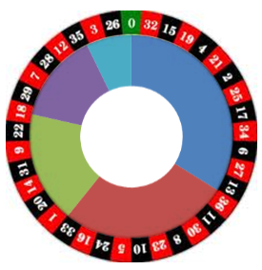
Flies vs Tomatoes
Selection - Roulette wheel
0.2
0.4
0.95
Take a note that every
fly has a chance to propagate
its genes!
0.5
0.75

Slide 28
Flies vs Tomatoes
Features
GA can find optimal solutions
GA can adjust solution in changing environment
Issues
May stuck in local optimum
Chromosome construction and related operations
can lead to distortions in GA
(for more search for schema theory, alleles)

Slide 29
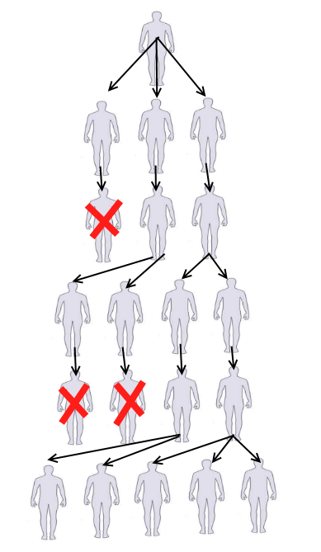
GA – Role of mutation over time
Changes done by mutation
that are leading towards solution
are propagating and cumulating over time.
Mutation creates variation…
…favourable mutations gets selected…
…reproduction and mutation again…
…favourable mutations gets selected…
…reproduction and mutation again…

Slide 30
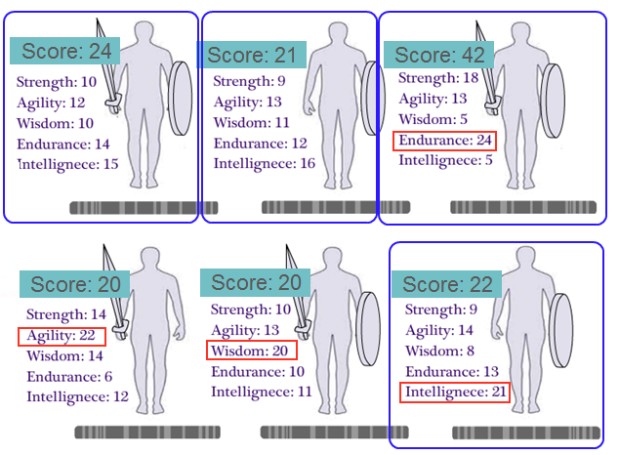
GA – Wide selection
By doing roulette wheel selection (giving chance to all guys proportionally
to their fitness) we can loose a lot of time
doing exploration of too many
possible solutions…
Who knows? Maybe only endurance
is important so why bother with the rest?

Slide 31
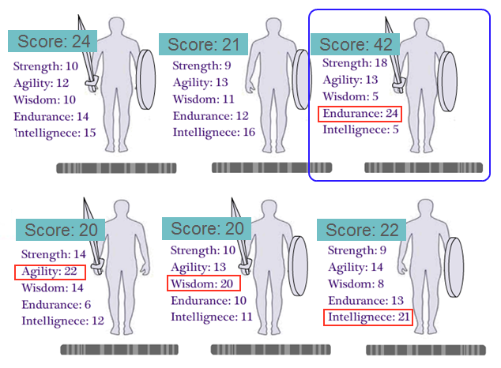
GA – Narrow selection
By doing elite selection (picking up guys with highest score)
we can loose opportunity of exploring for
other possible solutions…
Who knows? Maybe high enough agility, wisdom or intelligence can give us
much better results?

Slide 32
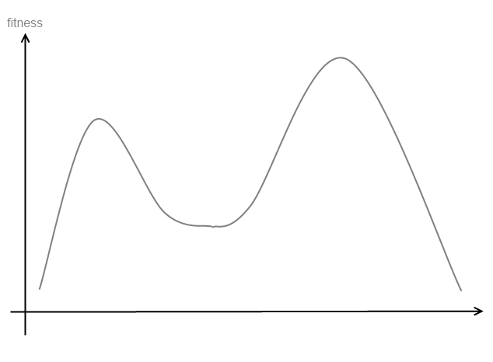
Know your enemy
Global optimum
Features of easily solvable search space:
Global optimum
Few local optimums
Hills to climb
Local optimum
Hill
Hill
Hill
Hill

Slide 33
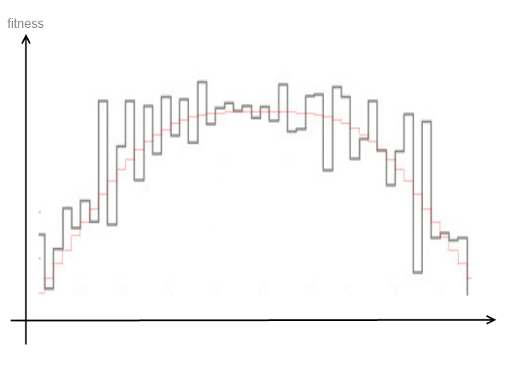
Know your enemy
Difficult search space lacks one or more features:
Where is global optimum?
Why there are so many local optimums separated in so rough way?!
Hey, there are no hills to climb!

Slide 34
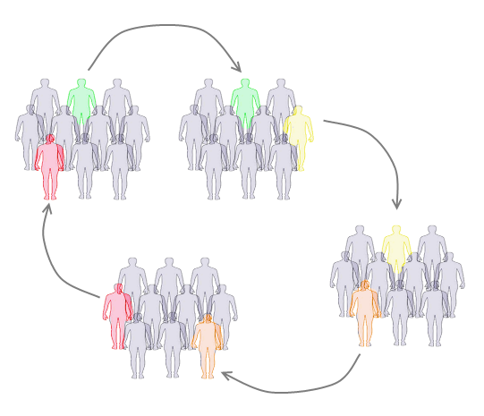
Co-evolution
Migrate successful chromosome from one population to another.
Combine solutions that stuck in local optimums and create even more fit individuals.

Slide 35
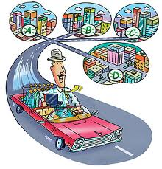
Solving complex problems
DEMO2
Traveling Salesman Problem
This demo uses AForge.Net library, check: www.aforgenet.com
And TSP problems library from Heidelberg university: http://www.iwr.uni-heidelberg.de/groups/comopt/software/TSPLIB95

Slide 36
Traveling Salesman Problem
Definition
There is a set of cities salesman needs to visit.
Each city must be visited once.
Task
What’s the shortest way through all the cities?

Slide 37
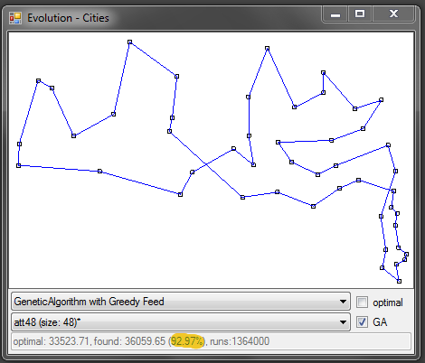
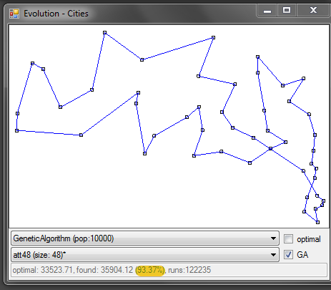
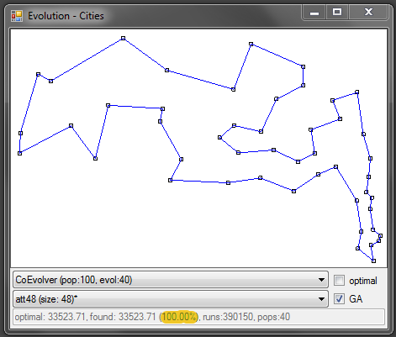
Traveling Salesman Problem
Search space size for 48 cities problem is 1.24e+61
(which stands in short for: 124139559253607267086228904373375038521586354677760000000000)

Slide 38
Traveling Salesman Problem
Chromosome
Array of unique identifiers of cities
{ id1 id2 id3 id4 id5 }
Example: {1,3,2,4,5}
Permutation of identifiers defines city order in the route

Slide 39
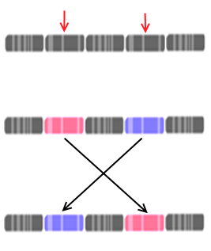
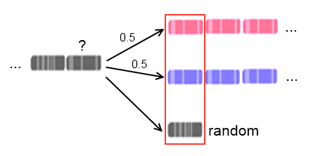
Traveling Salesman Problem
Crossover (as in AForge.Net implementation)
Mutation
(as in AForge.Net implementation)

Slide 40
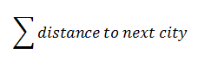
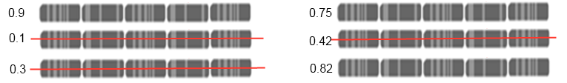
Traveling Salesman Problem
Fitness function
Selection – Elite selection

Slide 41
Traveling Salesman Problem
Features
GA can find optimal solutions… but what’s more important
it can find solution close to global optimum quite fast!
Issues
May stuck in local optimum
The larger problem is, the longer we count (obvious)
Vulnerable to chromosome construction
and used method of mutation, crossover and selection

Slide 42
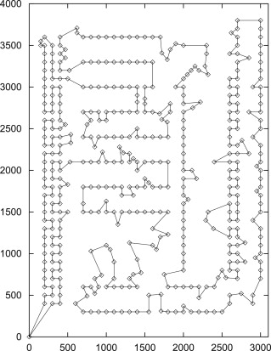
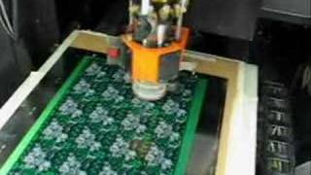
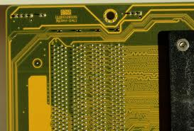
Traveling Salesman Problem
TSP applies to real world problems!

Slide 43
GA applications
Acoustics
Aerospace engineering
Astronomy and astrophysics
Chemistry
Electrical engineering
Financial markets
Game playing
Geophysics
Materials engineering
Math and algorithms
Military and law enforcement
Molecular biology
Pattern recognition and data mining
Robotics
Routing and scheduling
Systems engineering
Source: http://www.talkorigins.org/faqs/genalg/genalg.html

Slide 44
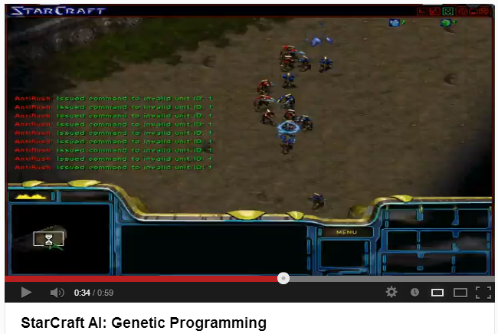
GA applications

Slide 45
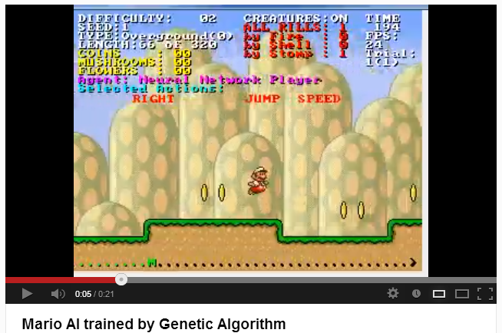
GA applications

Slide 46
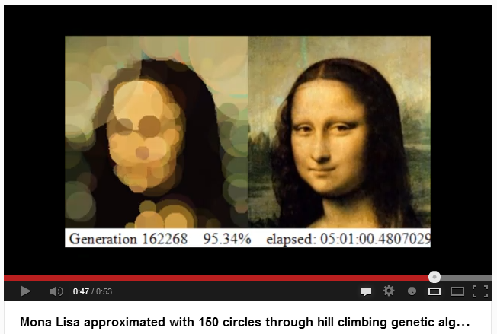
GA applications

Slide 47
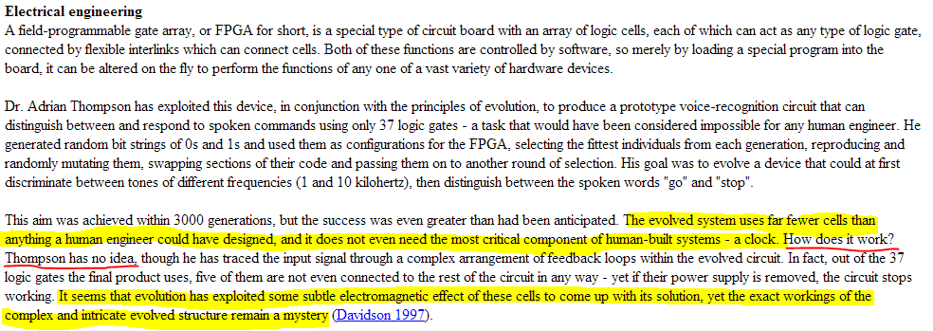
GA applications

Slide 48
Questions
and
Answers

Slide 49
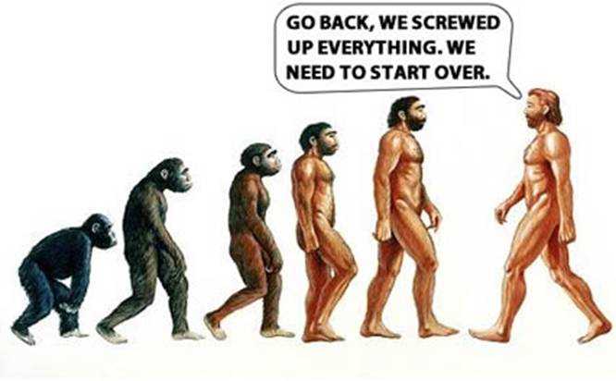
Genetic Algorithms
Thank you for your attention!

